Slide 1

Integrated Analysis of Social Media and Hedonic House Prices for Neighbourhood Change (INTEGRATE)
Nick Malleson, Alexis Comber, Thanh Bui Quang, Hang Nguyen Thi Thuy, Minh Kieu

Slide 2
Context: INTEGRATE
Research Aim
Analyse neighbourhood spatio-temporal changes to ..
… detect emerging house price bubbles through …
… the integration of social media data and hedonic house price models
… in three countries (UK, Vietnam, New Zealand)
Context
Gentrification is a key driver of house price dynamics and strongly linked to area reputation
Yet traditional house-price models estimate value from properly and location attributes
Fail to capture place-related characteristics, e.g. reputation or what people think of an area
Notes:
better understand the drivers of neighbourhood change and, in particular, the important role that social factors play in house price dynamics (a substantial research gap).

Slide 3

Data and Methods
Methods
“Methods grounded in text engineering and natural language processing (NLP) …”
Ask an LLM!
Data
Longitudinal house prices: Wenfresh / Zoopla rental prices and house prices (from the CDRC)
Text data:
Twitter (historical UK tweets)
Also: descriptions on AirBnB, descriptions of properties for sale (e.g. Rightmove), Events API, etc. – any suggestions??
Analyse the following tweets to determine their relevance to gentrification.
Consider indicators such as mentions of urban development, demographic shifts, displacement concerns, socioeconomic changes, and cultural transformations.
Assign a score from 1 to 5, where 1 means not suggestive of gentrification and 5 means highly suggestive.
Provide your answer strictly in the format ‘1. Score’, ‘2. Score’, etc., without any additional explanation or commentary.

Slide 4
Analyse the following tweets to determine their relevance to gentrification.
Consider indicators such as mentions of urban development, demographic shifts, displacement concerns, socioeconomic changes, and cultural transformations.
Assign a score from 1 to 5, where 1 means not suggestive of gentrification and 5 means highly suggestive.
Provide your answer strictly in the format ‘1. Score’, ‘2. Score’, etc., without any additional explanation or commentary.

Slide 5
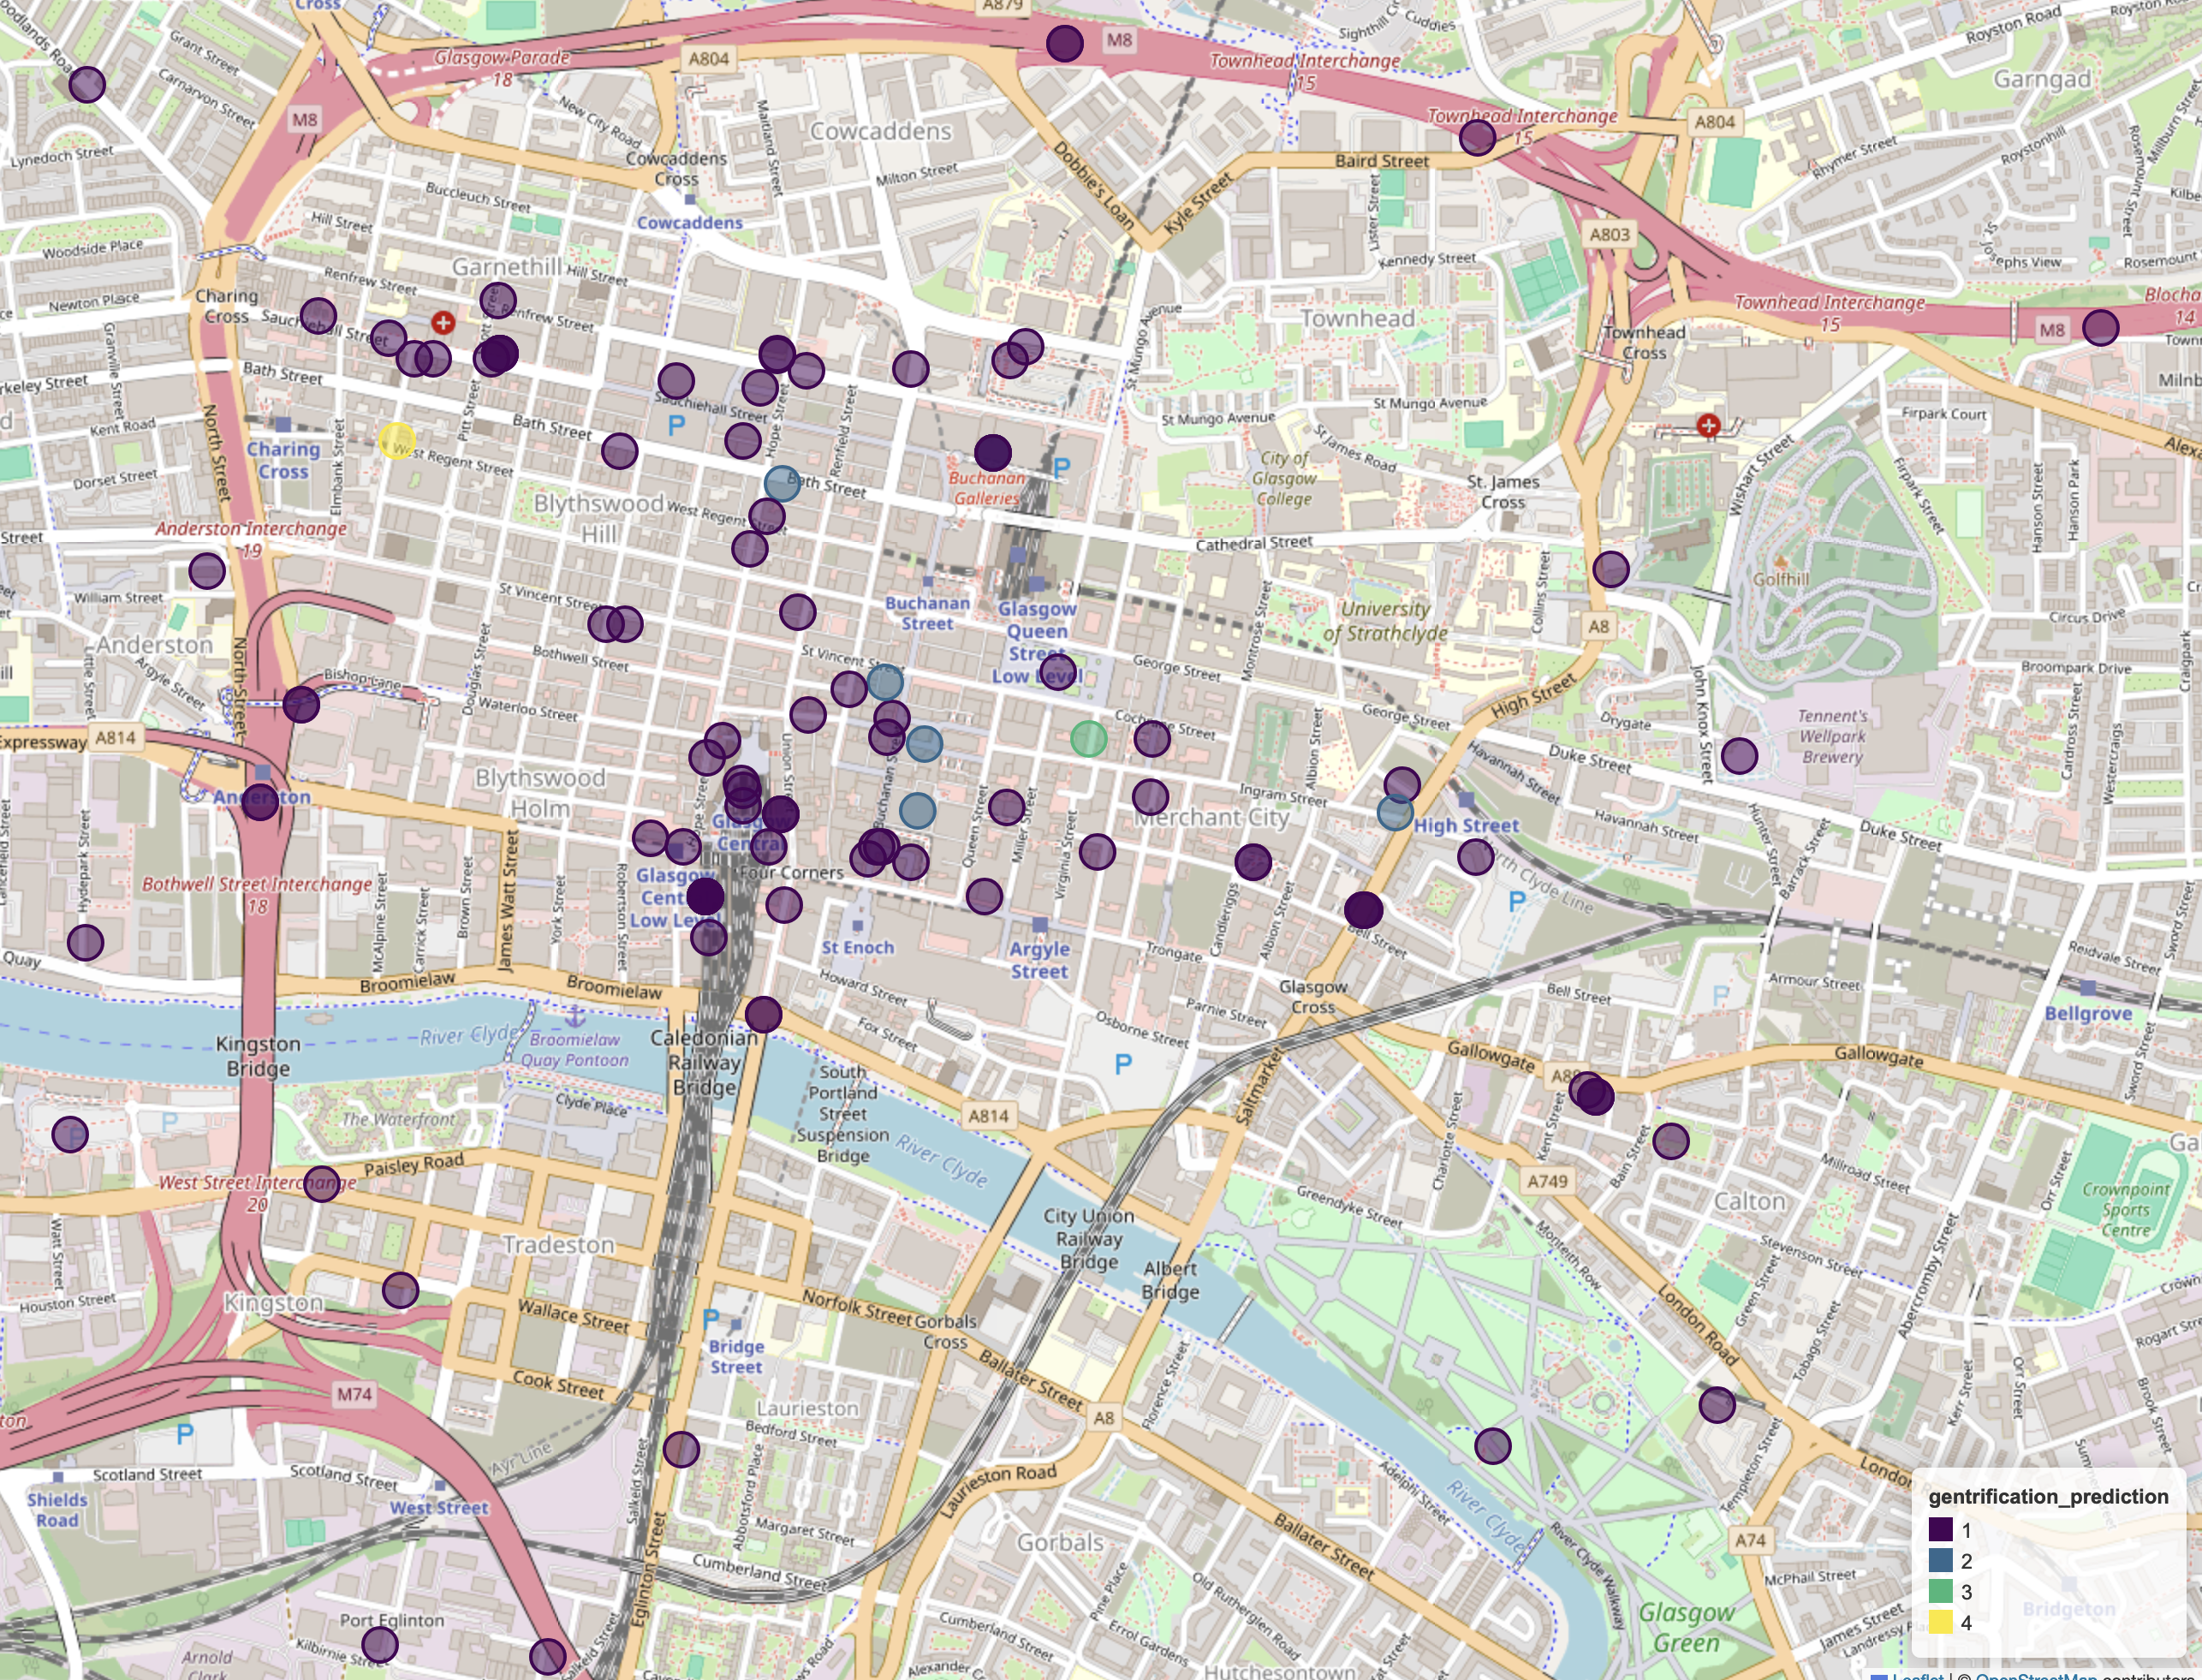
Preliminary Results
70bn parameter open source llama model (facebook)
Accessed through together.ai API

